Slide 1
UltraLite Coding
Nicholas Walter
Max Maier
Tyler Hogenson
Ben Finnerty
Spencer Lofing

Slide 2
How did we work?
We had regular weekly meetings.
Usually on Sundays.
We communicated consistently, mostly via text.
We broke up work to be done as Issues on GitHub.

Slide 3
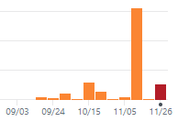
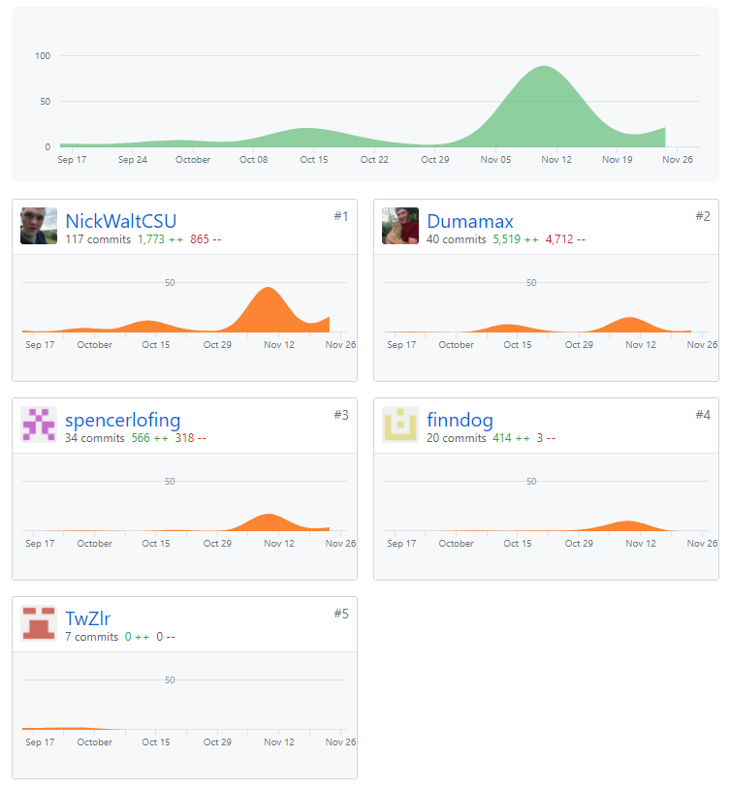
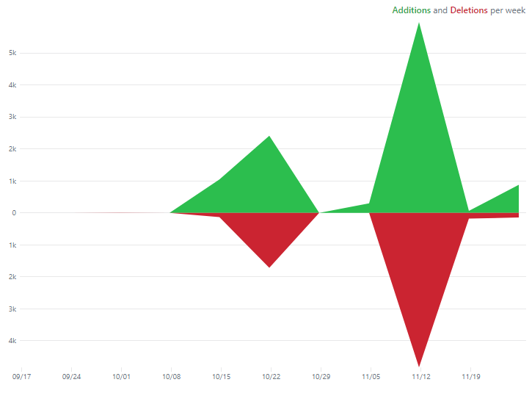
More Information

Slide 4
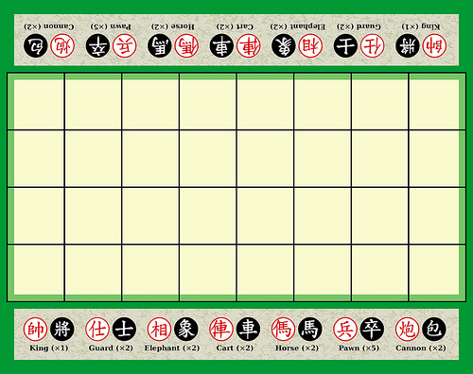
Banqi
Description of Banqi
Half/Blind Chinese Chess – game consists of tokens with various power levels, each placed face-down on the board in a random position. Tokens must be flipped face up (revealing color/power level) before you can move them – higher power level tokens can take lower power level tokens. Soldier can take General, General cannot take Soldier, Cannon can take anything (by jumping).

Slide 5
Code Improvements (Issues Closed)
#72 – Speed up Queries (Spencer)
#75 – Implement Forfeit Game, UI Side (Tyler)
#76 – Improvements to Active Games (Nicholas)
#77 – Add a Refresh to the Board (Tyler)
#82 – Hash Passwords (Spencer)
#83 – Fix Package Extensions (Max)
#86 – Fix Deregister (Spencer)
#88 – Show Color of User on Board (Tyler)
#91 – Implement Forfeit Game, Database Side (Spencer)
#93 – Implement Creator Color (Nicholas)
#95 – Fix Graveyard Issue (Nicholas, Max)

Slide 6
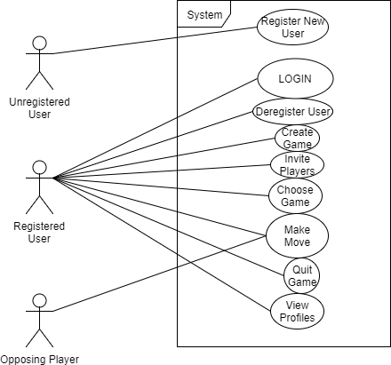
Use Case Document

Slide 7
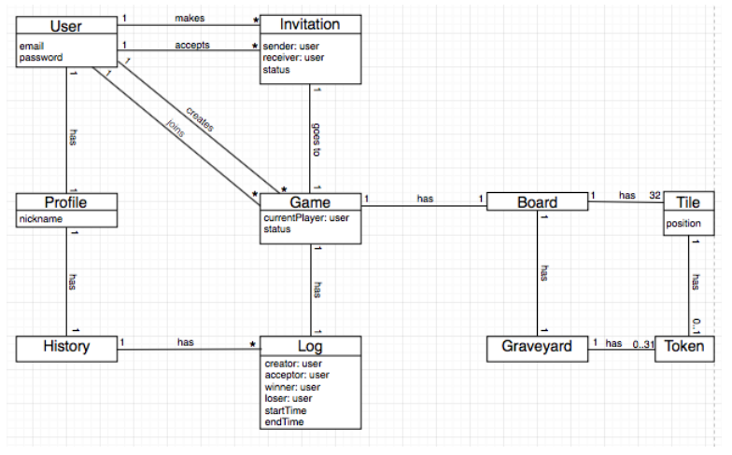
Domain Model Document

Slide 8
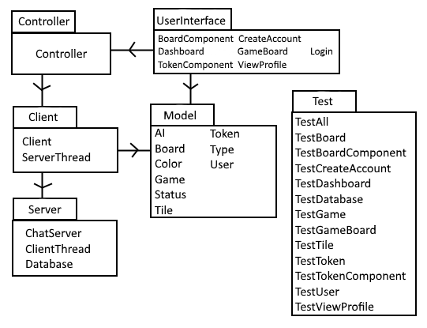
Design Document, Part 1, Package Diagram

Slide 9
Design Document, Part 2, Design Class Diagram

Slide 10
Design Document, Part 3, Sequence Diagram 1

Slide 11
Design Document, Part 3, Sequence Diagram 2

Slide 12
Design Document, Part 3, Sequence Diagram 3

Slide 13
Testing Document

Slide 14
Development Manual

Slide 15
Refactoring and Design Pattern List

Slide 16
Traceability Link Matrix

Slide 17
Challenges and Lessons Learned
Teamwork:
Challenge: we struggled to follow through on our plans.
Lesson: make more manageable plans.
Communication:
Challenge: we struggled to communicate our difficulties.
Lesson: communicate our difficulties.
Software Design:
Challenge: we struggled to do TDD or use Agile Methodology.
Lesson: making more time for work allows us to work how we want to.
Software Development:
Challenge: we struggled to implement as many design patterns as we would’ve liked.
Lesson: making more time for work allows us to implement what we want to.
Commit Log:
Challenge: 156 commits the week of November 12th.
Lesson: ensure all group members are doing their parts before the weekend before the due date.

Slide 18
Demo

